Slide 1
CS 201 DATA
STRUCTURES

Slide 2

COURSE INSTRUCTOR
Course Instructor: Zareen Alamgir Email: zareen.alamgir@nu.edu.pk Office Hours: TBA
🞄 TA: refer to google classroom for TA email

Slide 3
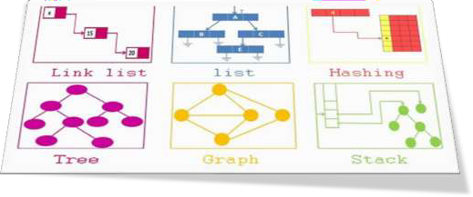
Introduce students to basic data structures and
related algorithms
Course Objectives
Develop the skills to analyze time and space requirements for a data structure and its associated algorithms
Prepare the students to pick the right data structure for a given problem

Slide 4

Pre-requisite
🞄 Computer Programming
🞄 It is assumed that students have a very good command on programming in C++.
https://www.goodcore.co.uk/blog/coding-vs-programming/

Slide 5
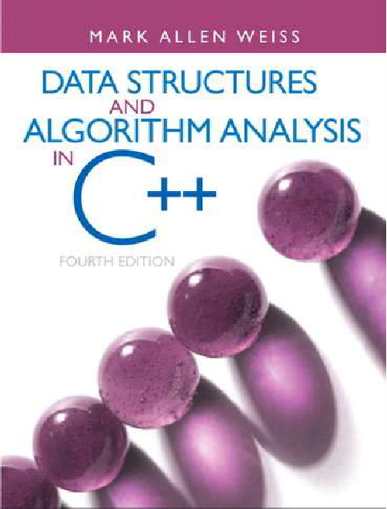
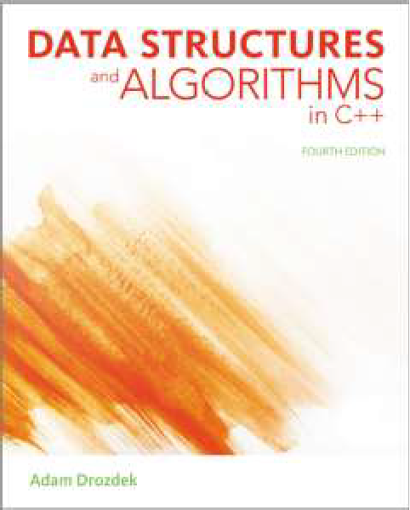
Data structures and algorithm analysis
Mark Allen Weiss 4th Edition
Textbook
Data structures and algorithms in C++
Adam Drozdek 4th Edition

Slide 6
Grading Scheme
🞄Midterms | 30%
🞄Quizzes | 10%
🞄HomeWorks | 0%
🞄Assignments | 20%
🞄Final: | 40%
Absolute grading scheme

Slide 7


🞄 There will be no makeup quiz.
🞄 Quiz can be announced or Surprise quiz. So always come prepared in the class.
Important
🞄 Submit assignments on time. No late assignments
will be accepted.
🞄 There is a strict policy against plagiarism and cheating. The penalty can be an F grade.
🞄 Be on time in class. All late comers will be marked absent.

Slide 8
Tentative
NO. OF LECTURES | TOPICS
1 | Introduction
2 | Time Complexity Analysis and Asymptotic Bounds
4 | Linked Lists Review of pointers Singly linked lists, doubly linked lists, circular lists and corresponding iterators
3 | Stacks and Queues
MIDTERM 1
2 | Recursion
3 | Trees Binary trees and their traversals Binary search trees (Insertion, Deletion and Search)
3 | Height Balanced Binary Search Trees (AVL Trees)
2 | Heaps and heap sort
MIDTERM 2
1 | Data compression and Huffman coding
2 | Hashing Hash tables and hash functions Collision resolution
2 | Universal hashing
3 | Graphs, Breadth first search and Depth first search
COURSE OUTLINE
&
LECTURE PLAN

Slide 9

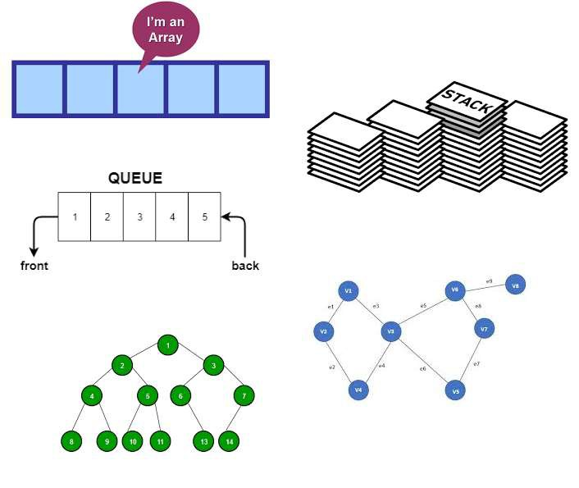

Introduction to DS

Slide 10

WHAT IS DATA STRUCTURES ABOUT?
A data structure is a way of organizing data so that it can be used efficiently
Data structures are a key to designing efficient algorithms as a good representation of data can enable us to process the data more efficiently

Slide 11


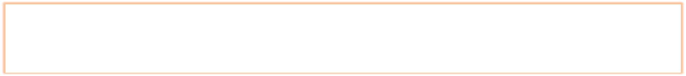
WHY DATA STRUCTURES ?
Design an efficient search engine, as good as Google’s
Build an efficient security system based on face recognition
Understand the human genome and trace your ancestry
Data structures are a key for designing efficient algorithms
What is an efficient algorithm ?
How do we know that algorithm is efficient ?

Slide 12




What does efficient
algorithm mean?
First let’s determine …
What is an efficient algorithm ?
Time & Space
efficient
If an algorithm takes 1 year to run and need 60TB of RAM
Then it’s probably
useless for us

Slide 13

We measure the cost of an algorithm in terms of time and space.
Time is usually considered more imp than space.
How can we determine the efficiency of an algorithm?
For now we will only concentrate on time …

Slide 14
🞄Idea 1: Code the two algorithms and note the time they take.
🞄 Issues:
🞄 The machine should be same,
🞄 The language should be same.
🞄 We need to code and then we can calculate the time complexity.
🞄 Is it a reasonable approach ?
🞄 Think ...
🞄 Conclusion: ?
How to compute Time Complexity?

Slide 15
🞄Idea 2: Compute the time complexity without programing (executing) the algorithm.
How to compute Time Complexity?
🞄 How ?
🞄 We need logical units that express a relationship between the size n of input and the time t required to process the given input.

Slide 16
Algorithm Analysis
ALGORITHM
Estimate the performance of an algorithm through
The number of operations required to process an input of certain size
i=0 sum=0
while(i<N ){ sum++ i++
}

Slide 17

Size of Input Matters
The differences between the algorithms may be immaterial for processing a small number of data items, but these differences grow with the amount of data.
Our aim is to see
How a program performs for reasonably large input

Slide 18
Suppose a machine that performs a million floating-point operations per second
(10⁶ FLOPS),
Number of operations matters
Then how long an algorithm will run for an input of size n=50?
If the algorithm requires n² such operations:
0.0025 second
If the algorithm requires 2^{n} such operations:
over 35 years!

Slide 19
Algorithm Analysis
🞄Estimate the performance of an algorithm through
🞄 the number of operations (t) required to process an input of size n
🞄 We require a function that express relation between n & t. We call it Time complexity function T(n)
🞄 To calculate T(n) we need to compute the total number of program steps
Program step can be an executable statement or meaningful program segment (comparison and assignment statements)

Slide 20
🞄 Each operation in an algorithm (or a program) has a cost.
➔ Each operation takes a certain amount of time.
🞄 count = count + 1;
➔ in this case time taken is constant (not depended on input)
🞄 To keep things simple let's assume each statement takes 1 unit of time (logical)
A sequence of operations:
The execution Time of Algorithms
count = count + 1;
sum = sum + count;
➔ Total Cost = 2
1 unit of time
1 unit of time
20

Slide 21
Example: Simple If-Statement
Cost
# of Times
1
1
if (n < 0)
absval = -n else
absval = n;
Total Cost <= 3
1
1
Simple
If-Statement
1
1
We are usually concern with the frequency of each statement
To make things simple and rough estimate of the run time of algorithm we consider all cost are same as 1 unit of time
21

Slide 22
Algorithm
Cost (time complexity)
i=0;
sum = 0;
while(i<N ){
sum ++;
The condition always
Analysis of
Loop
executes one more time
than the loop itself
i++
}
22

Slide 23
Algorithm
Cost (time complexity)
i=0;
sum = 0;
while(i<N ){
sum ++; i++
}
1
1
The condition always
N+1 N
executes one more time
Analysis of
Loop
than the loop itself
N
T(N) = 1 + 1 + N+1 + N + N T(N) ⁼ 3N+3
23

Slide 24
🞄 A program step is the syntactically / semantically meaningful segments of a program
🞄 A step DOESNOT correspond to a definite time unit but a
logical one
Calculating T(n)
Program
step
A step count is telling us how run time of a program changes with change in data size
Calculate the total number of steps/executable statements in a program
Find the frequency of each statement
Sum them up
Algorithm | T(N)
i=0; | 1
sum = 0; | 1
while(i<N ){ | N+1
sum ++; | N
i++ | N
}

Slide 25
Purpose of algorithm analysis
To estimate how long a program will run.
To estimate the largest input that can reasonably be given to the program.
To compare the efficiency of different algorithms.
To help focus on the parts of code that are executed the largest number of times.
To choose an algorithm for an application.
25

Slide 26
TO DO
Revise Computer programming concepts
Chapter 1 of Alan Weiss’s book Chapter 1 of Adam Drozdek’s book

